Slide 1
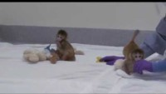

Slide 2
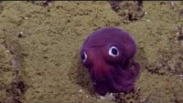

Slide 3
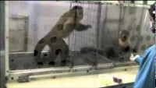

Slide 4


Slide 5
Exam Tips
Compare AND contrast
Need how they are similar and how they are different
Location AND appearance
Need where it is and what does it look like
Check the question vocabulary
Structural or Functional, make sure you are describing the right thing

